Slide 1




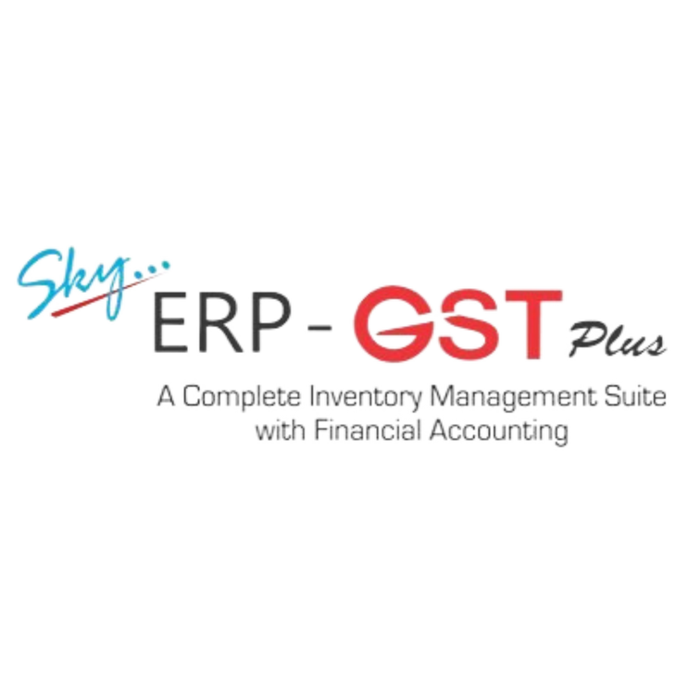



SKY ERP GST PLUS
with Financial Accounting
A Comprehensive Inventory Management, GST Compliance,
and Financial Accounting Solution

Slide 2

Category
TABLE OF CONTENTS
Introduction to SKY ERP GST PLUS
Key Challenges in Business Management
Solutions Offered by SKY ERP GST PLUS
Key Functionalities Overview
Order Processing
Material Resource Planning
Inventory Management : 1. Purchase 2. Production 3. Sales
Job Work Management
Quality Control
Document Management
Financial Accounting

Slide 3
Category
TABLE OF CONTENTS
Case Study 1
Case Study 2
Conclusion
Contact us

Slide 4







INTRODUCTION
SKY ERP GST PLUS is a comprehensive Inventory management & GST compliance software developed by Everex Infotech.
It enables organizations to ensure GST compliance, manage inventory, process orders, plan material resourcing and track job work, seamlessly.
The software helps businesses streamline their operations from purchase to sales, including GST returns.
Ensure GST Compliance
Streamline Financial Processes
Improve Operational Efficiency
Enhance Data Accuracy
Enable Informed Decision-Making
Optimize Resource Utilization
Improve Collaboration Across Departments
Scalable for Business Growth

Slide 5


CHALLENGES + SOLUTIONS
 | Challenges | Solutions
GST Compliance Management | Keeping up with frequent tax updates and filing returns accurately | Automate tax calculations, return filing, and compliance reports to avoid penalties
Inventory Management & Tracking | Difficulty in tracking real-time stock levels, leading to overstock or stockouts | Real-time inventory tracking, alerts for low stock, & purchase order management
Order Processing Efficiency | Manual processing of orders can lead to delays and errors. | Automated sales & purchase order speeds up order fulfilment and reduces errors
Managing Job Work Outsourcing | Complex tracking of material sent for job work orders with external vendors | Job work management tools track order progress, completion, and materials used
Document Handling & Compliance | Losing important documents and failing to adhere to compliance requirements. | Centralized document storage & easy retrieval ensures compliance
Financial Reporting & Accounting | Inconsistent financial data leads to mismanagement of cash flow & profit-loss reports | Integrated financial accounting system provides accurate financial reports, tax filings, and ledger management

Slide 6
CHALLENGES + SOLUTIONS
 | Challenges | Solutions
Inconsistent Data across Departments | Inconsistent & outdated information across different departments | Ensure all departments access the same r information, improving collaboration
Time Consuming Manual Data Entry | Manual data entry for transactions is time-consuming & prone to human error. | Automate data entry, reducing manual errors and saving time.
Difficulty in Tracking Material Usage | Unmonitored material usage can be complex & lead to wastage or shortages | Track material usage at each stage, helping businesses monitor consumption
Lack of Detailed Reporting | Standard reports make it hard to get insights for decision-making. | Offers detailed reports, so businesses can generate insights based on real-time data.
Delays in GST Return Filing | Late or incorrect GST return filing can lead to penalties and compliance issues. | Automated GST return filing reminders ensure timely & accurate filing
Complex Financial Reconciliation | Reconciling financial transactions can be challenging and error-prone | Seamless reconciliation features, integrating payments, taxes, and ledgers for accurate financial reporting

Slide 7





SKY ERP GST PLUS
FEATURES
Web/Browser-Based Application
Digital Signature Integration
Maker Checker
(Multi-Level) Approval System
Access the software from anywhere using any device with internet connectivity, providing flexibility and remote access for users. Also, host the application on premises or on cloud server.
Secure documents and transactions with integrated digital signatures for authentication, enhancing security and compliance.
Multi-level approval workflows ensure accountability, allowing different user roles to review and approve transactions or documents before finalizing.

Slide 8






Single Entry
System
User Defined Field Creation
MRP (Price) Based
Calculation
Simplifies data entry with a single-entry mechanism that reduces duplication and errors, making processes faster and more efficient.
Customize the software by creating user-defined fields to capture specific information based on business requirements.
Automatic calculations based on the Maximum Retail Price (MRP), ensuring accurate pricing and taxation for products.
Amortization Rate Calcualtion
Document Management
HSN Code/Chapter-Wise Auto Tax/Duty Control
Integrated amortization functionality helps calculate the gradual reduction of asset value or loan payments over time, ensuring precise financial tracking.
Centralized storage for all business documents with easy access, version control, and backup, ensuring organized document handling and compliance.
Automatically applies correct tax rates based on the HSN (Harmonized System of Nomenclature) code, streamlining GST and duty calculations.

Slide 9





User-Wise Access Rights with Log Management
E-Invoice & E-Way Bill Integration
Multiple Units of
Measurement
Assign user-specific roles and permissions with detailed log management to track changes and maintain security and control over sensitive data
Generate and manage e-invoices and e-way bills, either manually or via Web API integration, to comply with government regulations effortlessly.
Supports multiple units of measurement (e.g., weight, volume, length) for inventory management, ensuring accuracy in transactions & reporting.
Barcode & QR Code Integration/Recognition
Document & Report Generation in PDF
Inventory Management
(Process-Wise with Multi-UOM)
Integrate barcode and QR code scanning for faster product identification, inventory tracking, and streamlined order processing.
Generate reports and documents in PDF format and export data seamlessly to MS Word and MS Excel for further editing or sharing.
Manage inventory at each process level (purchase, production) with support for multiple units of measurement, ensuring accuracy and control.

Slide 10




Material Resource Planning
Bill of
Material
Inventory Management
Lot No. & Batch No. Wise
Plan production and procurement efficiently based on demand forecasting, raw material availability, and lead times, reducing delays and stockouts.
Create and manage detailed Bills of Material for manufacturing processes, linking raw materials, semi-finished, and finished goods for accurate cost and production tracking.
Track inventory at lot and batch level, enabling detailed analysis of product performance, wastage control, and cost optimization.

Slide 11









KEY FUNCTIONALITIES
Order Processing
Quality Control
Material Resource Planning
Inventory Management
Job Work Management
Order Processing module streamlines sales & purchase cycles by automating quotations, orders, invoices, & GST integration for faster & error-free transactions.
Quality Control module ensures defect-free operations with user-defined inspections, real-time reporting, & automated alerts for non-conformance at every stage of material handling.
Material Resource Planning module optimizes production and procurement by forecasting demand, scheduling resources, and aligning materials with Bill of Material for timely delivery.
Inventory Management module provides real-time stock visibility, process-wise control, & lot/batch tracking to ensure accuracy, efficiency, & profitability.
Tracks external job orders, monitors material usage, & ensures timely completion with automated reporting & GST compliance
Financial Accounting
Document Management
Automates GST-compliant bookkeeping, reconciliation, & financial reporting, insights for smarter business decisions.
Centralizes digital storage, enables role-based access, & ensures secure, organized, and easily retrievable business documents.

Slide 12
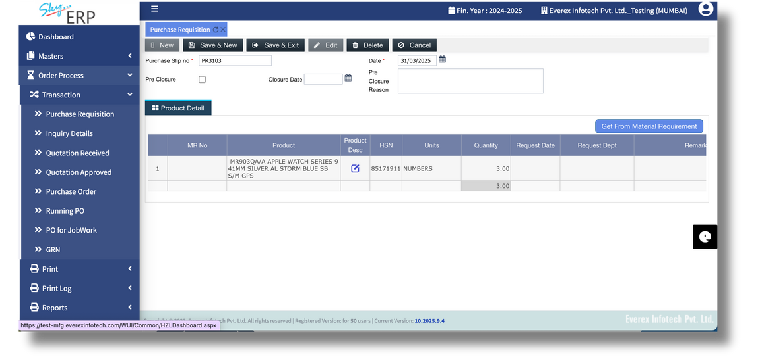


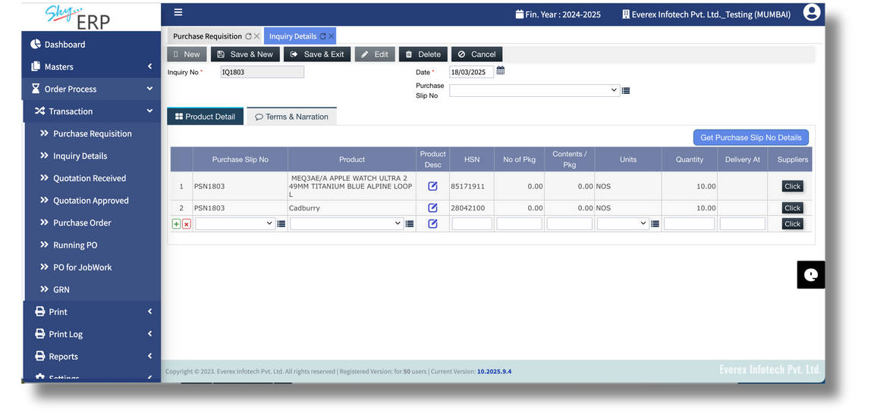


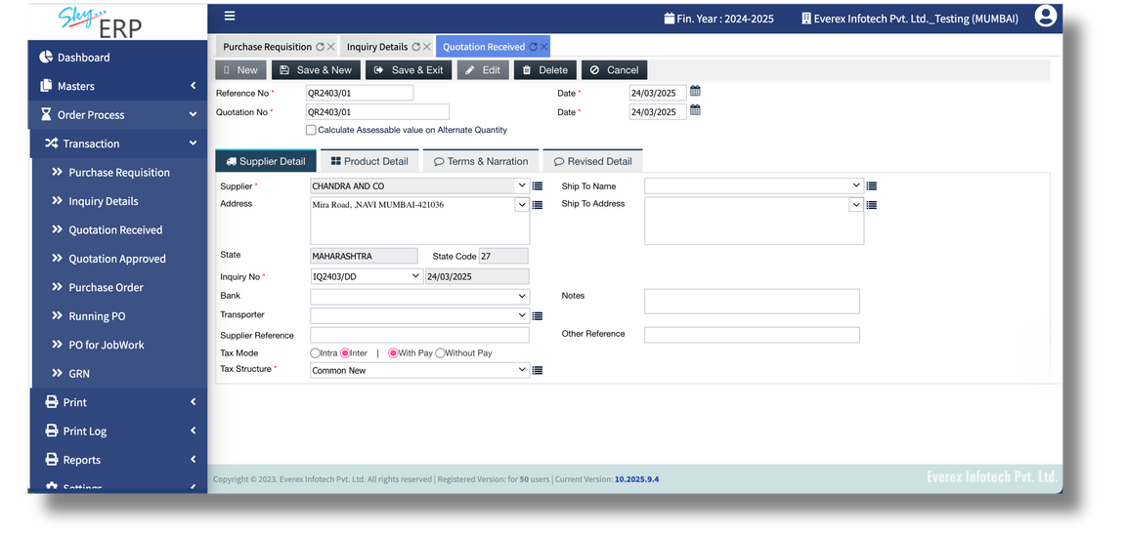
ORDER PROCESSING
Order Management
Purchase Requisition
End-to-end sales & purchase order management
Simplified procurement by enabling structured request creation
Incoming Quotation
Order Status
Incoming quotation from vendors
Order status tracking with real-time updates
Order Processing module streamlines sales and purchase cycles by automating quotations, orders, and GST integration for faster and error-free transactions.

Slide 13
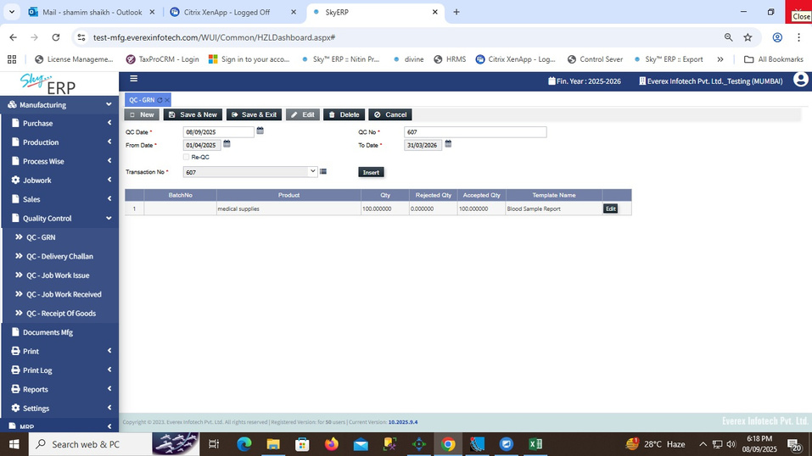
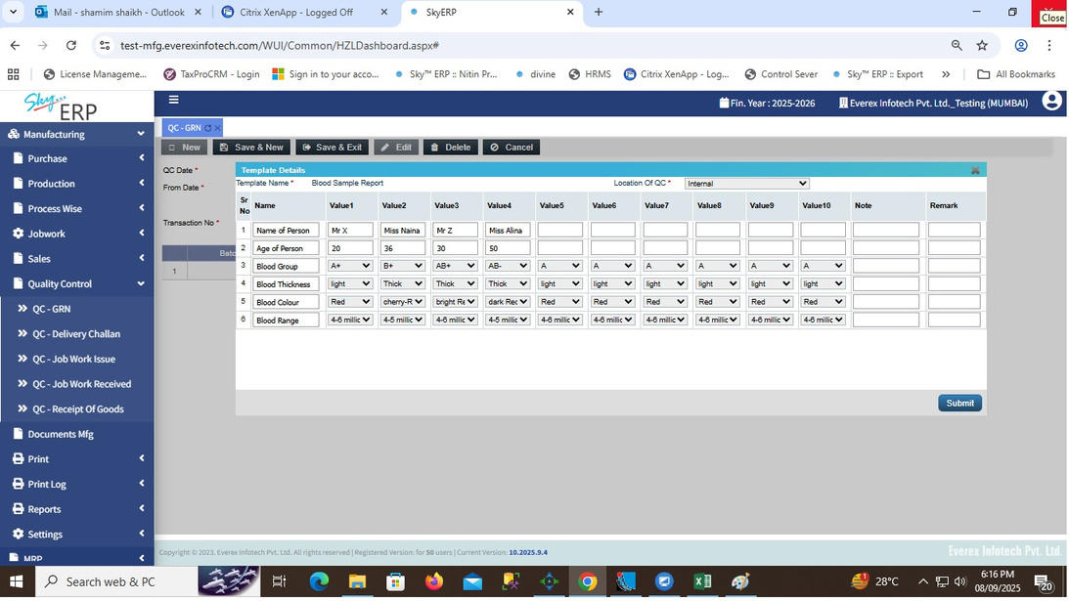
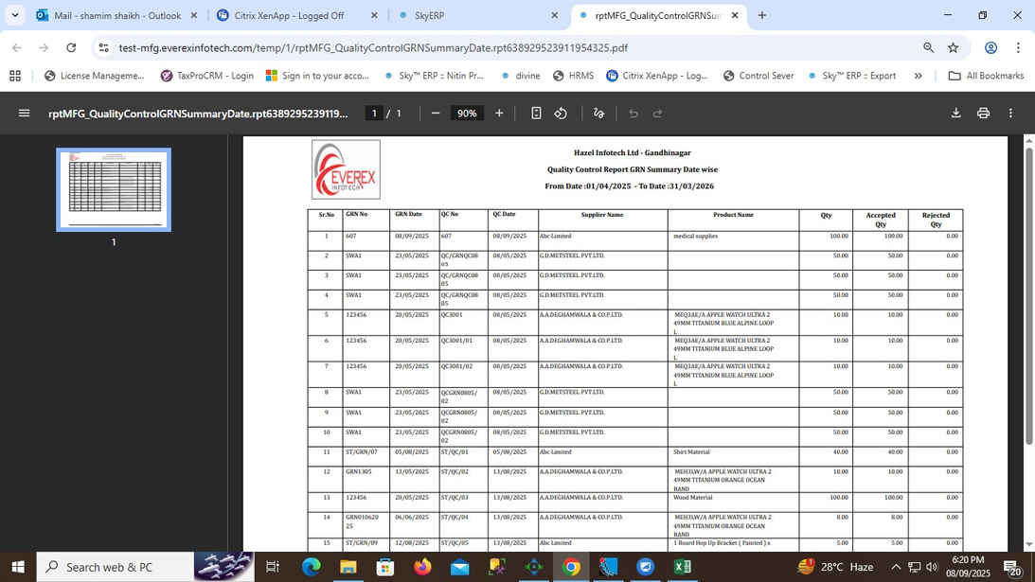
QUALITY CONTROL
Quality Templates
Multi-Level Inspection
User-defined quality templates at GRN, delivery challan, job work issue, job work received, receipt of goods stage
Multi-level inspection (material inward, production, job work)
Quality Reporting
Real-time quality reporting & defect analysis
Quality Control module ensures defect-free operations with user-defined inspections, real-time reporting, and automated alerts for non-conformance at every stage of material handling.

Slide 14
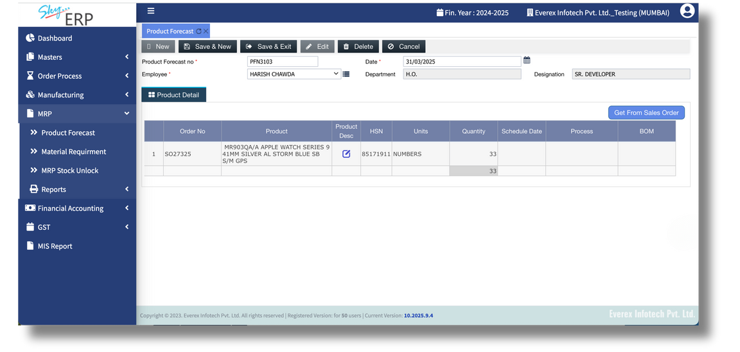

MATERIAL RESOURCE PLANNING
Forecast Demand
Bill of Material
Forecast demand and align raw material procurement
Integrated with BOM (Bill of Material) for accuracy
Optimize Resources
Cost Control
Optimize resources to reduce delays & stockouts
Cost control through efficient resource allocation and wastage reduction
Material Resource Planning module optimizes production and procurement by forecasting demand, scheduling resources, and aligning materials with Bill of Material for timely delivery.

Slide 15
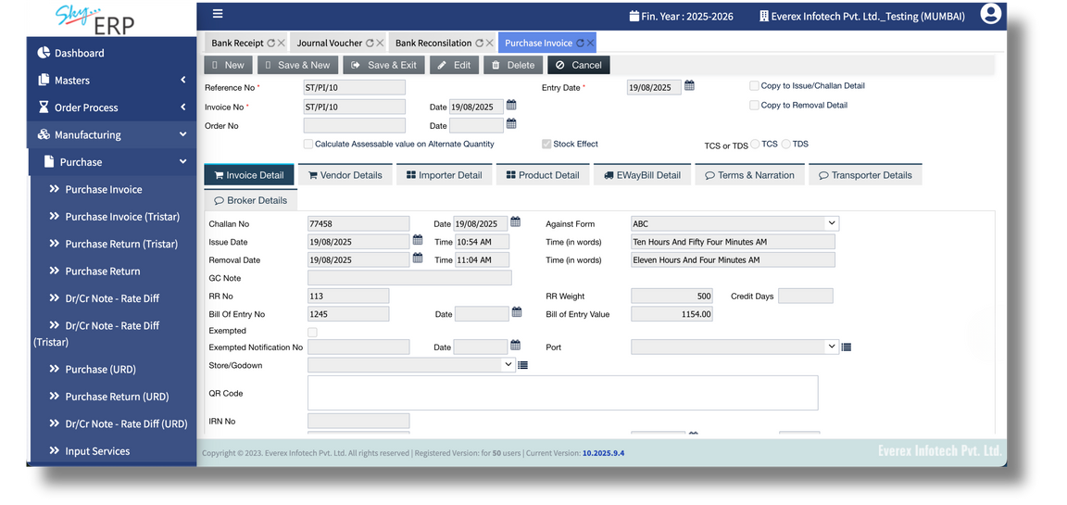
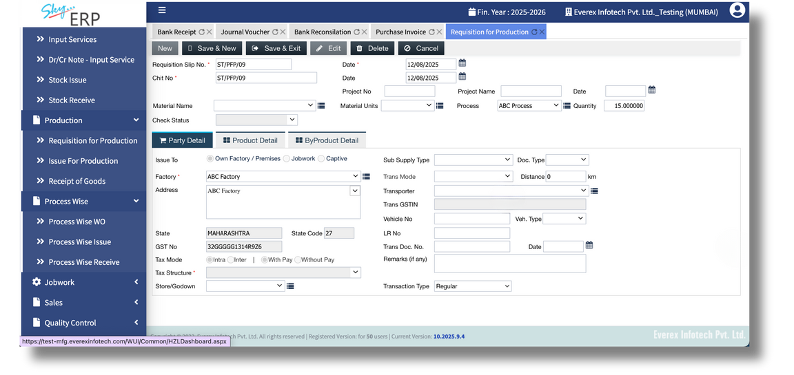


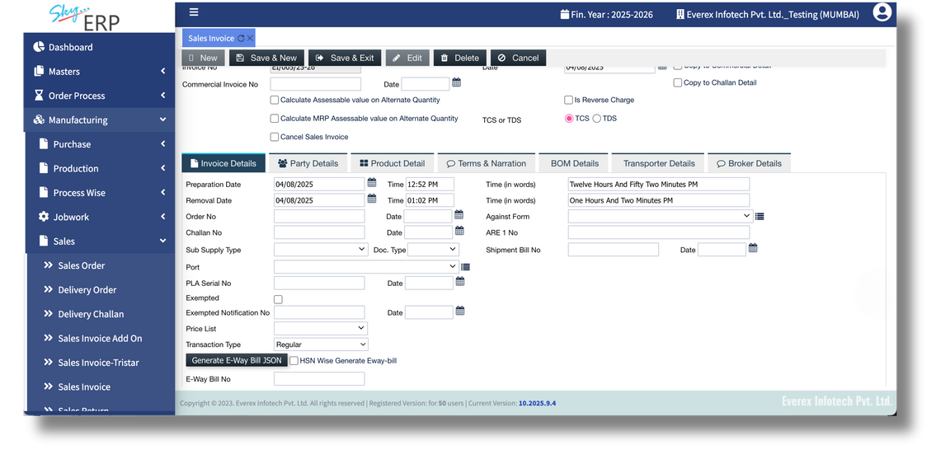
INVENTORY MANGEMENT
Stock Register
Stock Alerts
Stock register across multiple locations for complete visibility
Real-time stock alerts to prevent shortages
Multiple Godown Register
Lot & Batch Wise Inventory
Multiple godown register for accurate warehouse-level inventory
Generate lot-wise & batch-wsie inventory details
Process-Wise Inventory
Order Integration
Process-wise inventory control with multiple units of measurement
a. Job work wise
b. In house Production wise
Comprehensive work order for purchase & sales order integration
Inventory Management module provides real-time stock visibility, process-wise control, and lot/batch tracking to ensure accuracy, efficiency, and profitability.

Slide 16
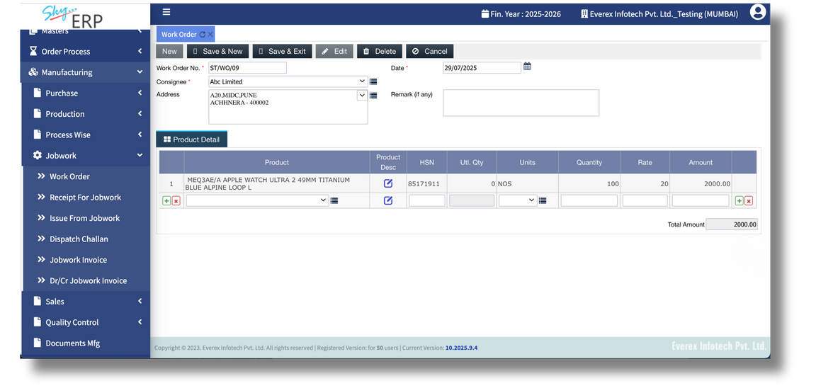
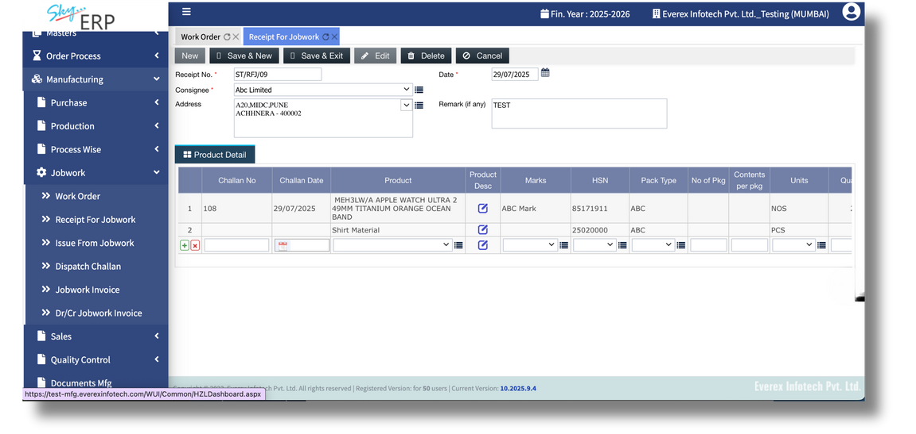
JOB WORK MANAGEMENT
Inward/Outward Tracking
Complete Monitoring
Manage external job orders with inward & outward tracking
Monitor completion status, timelines, and material usage
Billing & Compliance
Reports
Automated job work billing & GST compliance with multiple challan outward to single tax invoice
Reports for pending & completed job orders
DR/CR Note
Enable accurate adjustments in invoices for returns, discounts, or corrections
Job Work Management module tracks external job orders, monitors material usage, and ensures timely completion with automated reporting and GST compliance

Slide 17
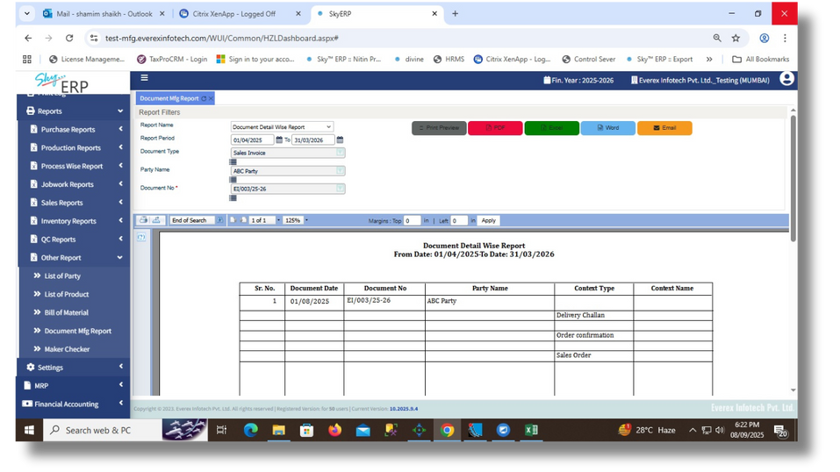
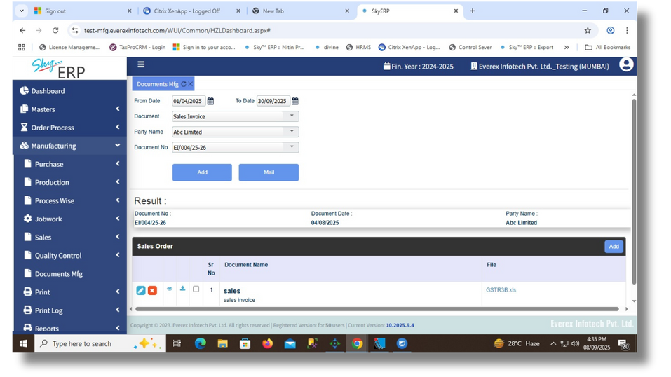
DOCUMENT MANAGEMENT
Centralized Repository
Centralized digital document repository
List of Documents
Generate list of documents category wise
Document Management module centralizes digital storage, enables role-based access, and ensures secure, organized, and easily retrievable business documents.

Slide 18
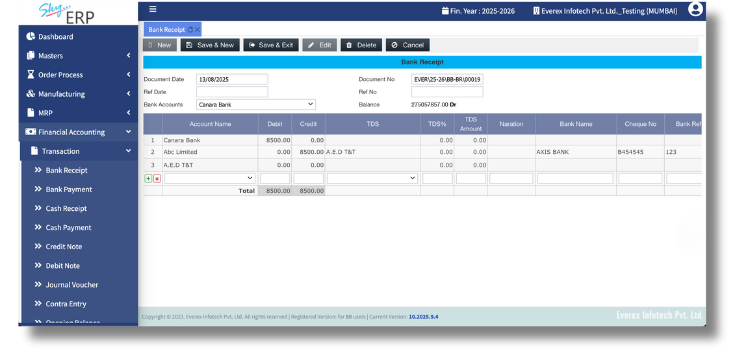
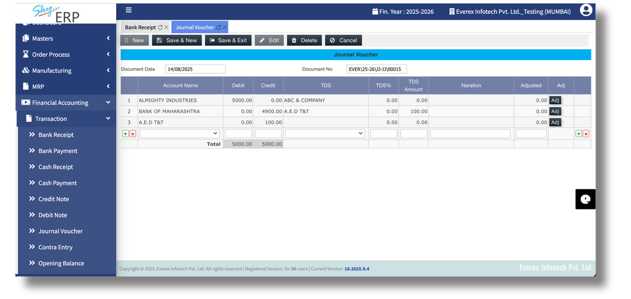
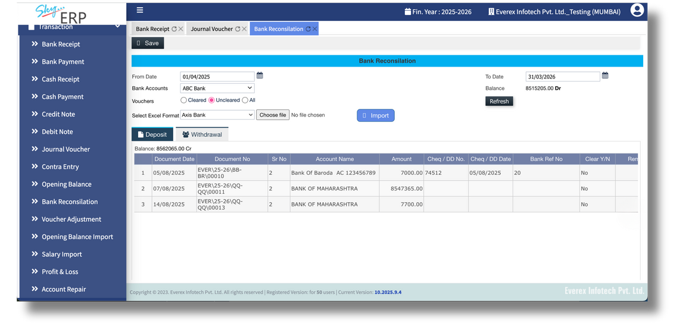
FINANCIAL ACCOUNTING
Journal Entries
Financial Reporting
Automated journal entried linked with transactions
Financial reports: Profit & Loss, Balance Sheet, Cash Flow, Ageing, Outstanding, Graphical Reports
Bank Reconciliation
Ledgers
Bank reconciliation with Excel import export
Trial balance, general ledger, and subsidiary ledgers
Petty Cash Entry
Compliance
Simplifies tracking of day-to-day expenses, ensuring accurate cash flow management
Tax filing, billing and audit-ready compliance
Financial Accounting module automates GST-compliant bookkeeping, reconciliation, and financial reporting, delivering accurate insights for smarter business decisions.

Slide 19




CASE STUDY 1
STREAMLINING GST COMPLIANCE FOR
A MANUFACTURING SME
Client Profile
A mid-sized auto parts manufacturer with operations in multiple states, managing over 200 monthly invoices and frequent interstate transactions.
Challenges
Manual GST filing leading to errors and penalties.
Difficulty in reconciling purchase invoices with supplier GST filings.
Delays in generating e-invoices and e-way bills.
Solution
Automated GST return filing with real-time reconciliation.
Integrated e-invoicing and e-way bill generation.
Centralized dashboard for compliance monitoring.
Results
100% error-free GST filings for 6 consecutive quarters.
Saved 40+ man-hours per month previously spent on manual compliance.
Improved cash flow visibility with accurate tax credit tracking.

Slide 20

CASE STUDY 2
ENHANCING QUALITY CONTROL & REPORTING FOR A PHARMA COMPANY
Client Profile
A pharmaceutical company supplying across India, requiring strict quality checks and compliance with GST regulations.
Challenges
Lack of structured quality control during GRN (Goods Receipt Note) stage.
Inconsistent reporting and delays in identifying defective material.
Difficulty in tracking GST credit due to mismatched entries.
Solution
User-defined quality control templates at GRN and material inward stage.
Automated quality reporting integrated with GST records.
Instant alerts for mismatched entries and rejected materials.
Lot-wise & batch-wise inventory management for detailed tracking.
Process-wise inventory management for work in production.
Results
Reduced defective material usage by 25%.
Faster decision-making with real-time quality & GST reports.
Compliance accuracy increased, eliminating GST credit mismatches.

Slide 21





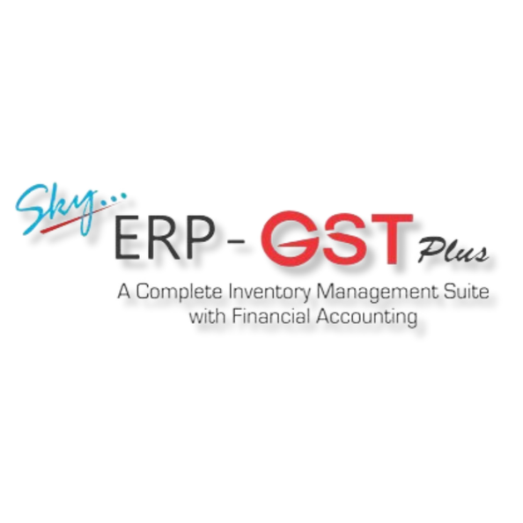


Conclusion
SKY ERP GST PLUS with
Financial Accounting is
designed to be a comprehensive solution for businesses looking to streamline their operations, stay compliant with GST regulations,
and ensure accurate
financial management.
Developed By

Slide 22






THANK
YOU
www.everexinfotech.com
sales@everexinfotech.com
+91 81 0434 5257
+91 22 4226 4444
26, Champa Gully, M. J. Market Lane, Mumbai 400002. INDIA

